Slide 1


Human-in-the-loop Optimization of Shared Autonomy in Assistive Robotics
Deepak Gopinath, Siddarth Jain and
Brenna D. Argall
Notes:
Change Master slide.

Slide 2
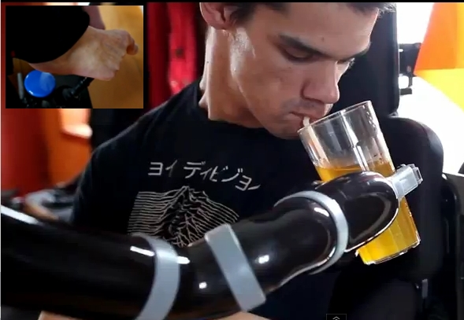

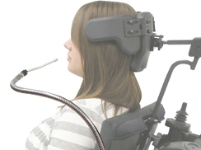
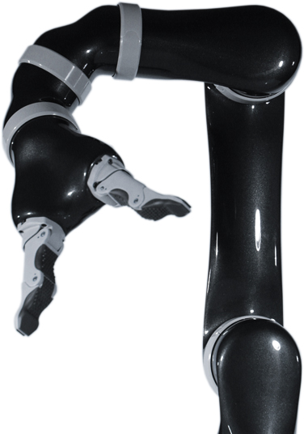
The need for shared autonomy
Motor Impairments
Limited Interfaces
Machine Complexity
Notes:
For people with motor impairments due to SCI, assistive devices are important to reduce their dependence on caretakers and improve their ability to perform activities of daily lives. However, the control interfaces that are typically used for controlling these devices are limited, discrete and operate in different modes.
The other issue is that of machine complexity. Here we are looking at a 6DOF robotic manipulator. However in most control interfaces can operate in 1,2,3 dimensional control space. This means to control the entire robot the user will have to switch between different modes that correspond to different parts of the control space. The introduction of partial autonomy can help to deal with these issues by reducing the physical and cognitive burden on the user. Shared control also ensures that the user is in the loop to some degree helping in better user satisfaction. Shared control can be of different types: heirarchical...and operating in the same space.
Situate the domain properly. Establish why shared autonomy is needed. Add more details to the control interface. 1-d, 2-d, 6DOF.

Slide 3
Why Customization?
Full Teleoperation
Predefined assistance levels need not remain optimal
User and task variability
Is there an optimal level of assistance?
Optimal
Assistance
???
SHARED CONTROL
Full Autonomy
Notes:
Control sharing in shared control assistive systems extends from full teleoperation at one end to full autonomy. Customization of assistance levels in these systems can become important because pre-defined assistance levels need not remain optimal in the long run as users’ ability to control these device will likely be deteriorating due to degenerative diseases or improving due to successful rehabilitation. Furthermore, user preferences and task variability can also be important reasons for customization. So the question will be, is there an optimal level of assistance and if so, how we attain it?
This is good.

Slide 4

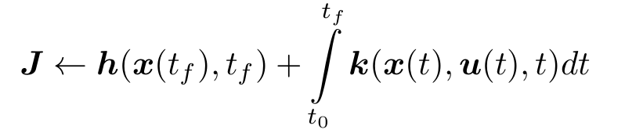

Customization as Optimization
Final Control
Command
Arbitration Parameters
Autonomous Control
Command
Human Control
Command
Terminal Cost
Running Cost
The exact nature of the cost function and system dynamics is unknown and left indeterminate
Notes:
Let beta be the arbitration function which arbitrates between the human control command and the autonomous control command and is paramterized by parameters theta(t) to produce a final control command ub(t). Customization of assistance level can then be formulated as an optimization problem in which a cost function J is minimized with respect to parameters theta(t). J is dependent on theta(t) through the system dynamics. However, standard optimization requires the specification of the form of cost function. In our work we do not try to make an attempt to determine the exact nature of the cost function or system dynamics.
This is fine as well. Underplay the word optimization

Slide 5

System Description
Blending Factor
Linear Blending
Learning from
Demonstrations
Blending factor as a parameterized function of confidence
Notes:
In our specific implementation, the human and robot autonomy signals are combined in using a simple linear blending paradigm, where alpha is the blending factor.
The parameter theta only affects alpha in our implementation and I will talk aabout how in a second. I also want to briefly mention that in our system, the robot policy is derived from demonstration provided beforehand. (describe the model learning process briefly)
So blending factor is parameterized function of confidence Confidence refers to the systems confidence in its estimate of the human intent. Suppose the user is trying to accomplish a reaching task. For each of the goals present in the scene, at every time step the system tries to compute a confidence measure. The goal with the highest confidence is chosen as the current goal. Talk about the specific form of confidence measure
The functional depnedence of alpha on confidence is shown here. There are three parameters. Talk about them. “optimize over the parameters” essentially amounts to changing the shape of this function.
-Make the equation less noise. Elaborate (add bullets) on what confidence is. Don't talk about LfD for u_r. Make labels bigger. Have same labels for the second plot.

Slide 6
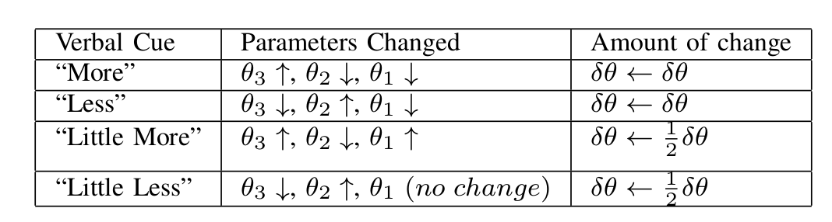
User-driven customization
Human-in-the-loop performs the optimization
Interactive and iterative optimization process (exploratory approach)
Notes:
Instead of relying on standard optimization tools we have the human who is in-the-loop to perform the optimization procedure. Verbal requests for changes in assistance from the subjects are mapped to parameter changes in a pre-specified manner.
- possibly remove first line. Elaborate the second line in speech.
- Reduce the table size to be half of what it is maybe and re introduce the arbitration function diagram to remind people what the thetas are.

Slide 7
Experimental Setup
17 subjects – 13 Uninjured, 4 SCI
Three tasks, Two control mappings (2D and 3D)
Three predefined levels of assistance -min, mid and max
Two rounds of customization
Metrics – Task Completion Time, Number of mode switches
Notes:
- don't go into details of what each task was about. Talk about how these different reaching tasks needed different kinds of goal poses.
- Add pictures and tables for 2d and 3d. Add arrows to show dimensions of control.
- Skip mentioning mid. Talk about customization and how they got to experience different levels of assistance before each data collection tasks. How they converged to custom level of assistance. (Pick the right words for this)
Before results show video of different levels of assistance in action.

Slide 8
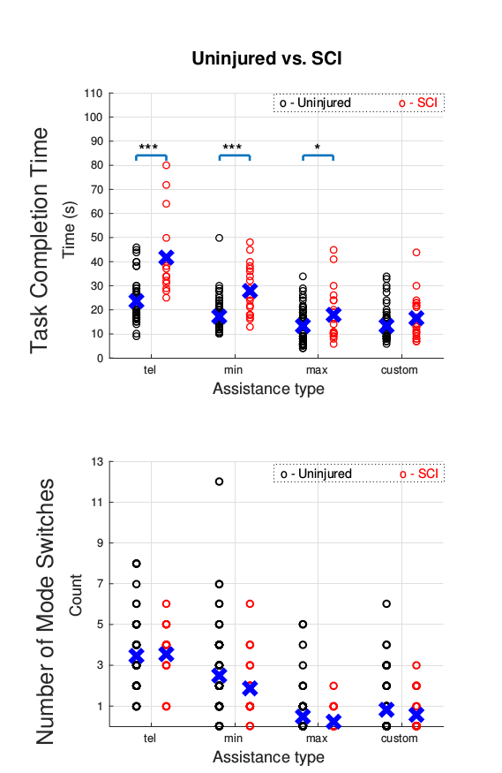
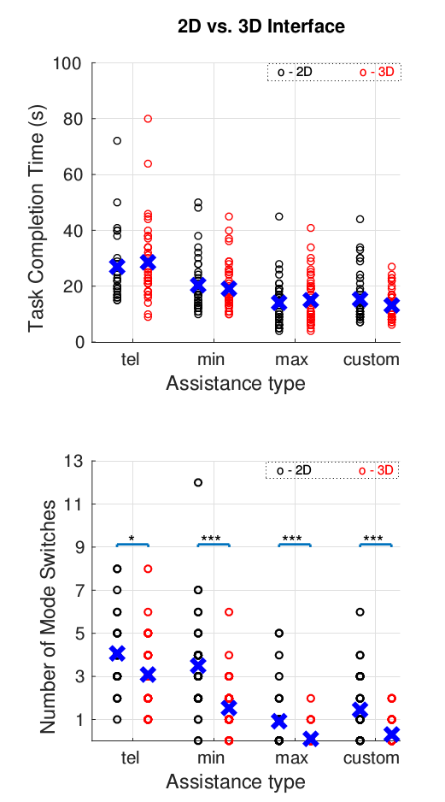
Results
Customization reduced performance differences between subject groups
However, no difference in mode switches
Across control mappings – no noticeable difference in task completion times
Notes:
First we look at results between subject groups. Describe the images briefly.
With customization, the task compleition times of SCI became caomparable to that of uninjured. Furthermore the variance in performance also decreased.
For mode switches there was no statisticaldifference between uninjured and SCI subject data for any of the assistance levels. This suggests that the number of mode switches is primarily determined by the nature of the task and control interface, and not the state of injury. However, SCI
subjects do take more time than uninjured subjects to perform
the same number of mode switches.
Now here we are looking at results between differents types of control mapping paradigms. Different operational modes do not seem to have an effect on task completion times. However there is significance in mode switches
The comparable task completion times may be explained
by the fact that easier control compensates for time lost
during mode switches. That is, due to the greater number of
mode switches required for the 2D interface compared to the
3D interface, more time is taken performing mode switches.
Change the tone in which I talk about no differences in mode switches. Change title of the slide to bring out the punchline. Should talk about cost function in this slide, don't put it off to the last slide. 7 out of 34, 14 out of 34....greater task time and mode switches.
With increasing assistance the different reduced, but only custom was able to eleiminate it.

Slide 9
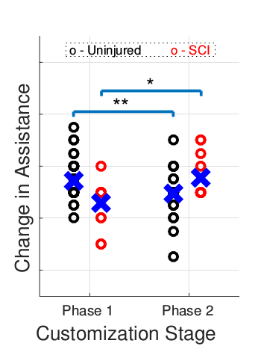
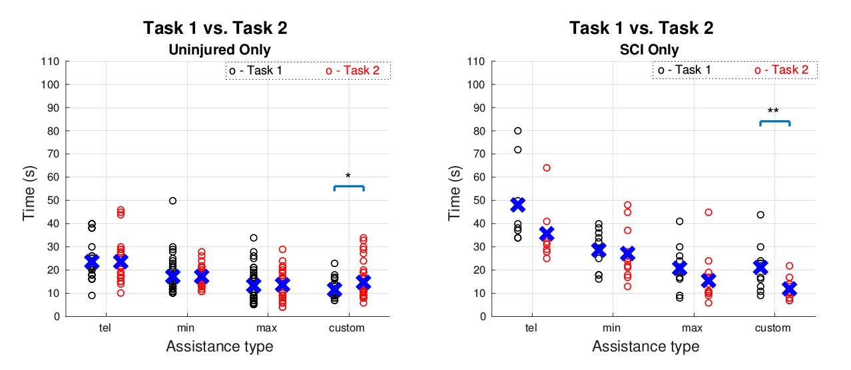
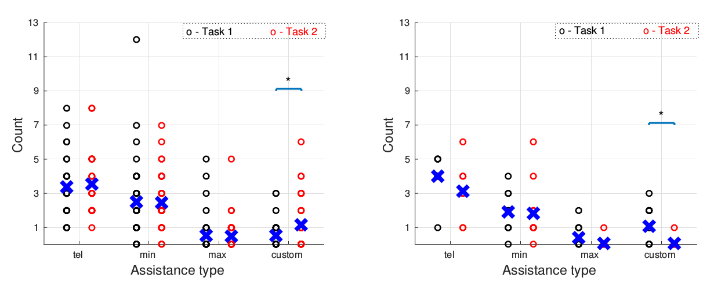
Results
Across tasks – Only custom showed performance difference for both time and mode switches
Insight into cost function
  7 customization rounds – custom > max (task completion time)
  14 customization rounds – custom > max (number of mode switches)
Notes:
And lastly we look at metrics across different tasks, that is the different stages of customization. SCI subjects on an average requested more assistance in the second stage of customization. Whereas uninjured chose to reduce the amount of assistance.
In the images on the right we can see the effect of these changes.A statistically significant difference in performance only is
observed for custom assistance, for both groups. And furthremore the trends are opposite that is, SCI chose for more assiatnce and the task compleition times reduced and the opposite was observed for uninjured.
Same trends were observed for mode switches as well. It is interesting to note that uninjured subjects chose lower assistance despite reduced performance. (Maybe not too critical)
And lastly I would like to talk about some insights into the cost function that the user might be optimizing over. This indicates that subjects
are not always optimizing for standard performance metrics—
because there does exist a parametrization (max) which was
known to the subjects and performs better with respect to these
metrics. This provides insight that the true cost function that
the user is optimizing likely is more complex than a simple
time-optimal or minimum-effort cost function.
- First bring left slide. Talk in terms of uninjured and Sci customized for more assistance (in bracktes put between two tasks).
= Show that this resulted in a change in performance. Interesting to note that Unjinjuured did so at the expense of perrofmnace. Organize plots accordin SCI (stack vertically the time and mode switches). And Uninjured.

Slide 10
Future work
New interfaces for customization – Buttons, sliders, knobs
Further investigations into the true cost function
When and when not to assist?
Notes:
Add conclusions slide, summarizing the presentation. Mention about additional physical interfaces as a last point. A more longitudinal study is going to be undertaken soon.

